Slide 1
Student Score Prediction by Implementing Linear Regression
Presented by :- Mahima (241000050103) & Anish Singh (241000050104)
Presented to :- Dr. Neetu Singla (Assistant Professor)

Slide 2
What is Linear Regression?
Linear Regression is a statistical method that models the relationship between a dependent variable and one or more independent variables.
It is one of the supervised Machine Learning Algorithms
Here, the variables are; Dependent - Score Independent - Hours
Goal: To find the 'Line of Best Fit' that minimizes the error between actual and predicted values.

Slide 3
Dataset Used
The dataset (student_scores.csv) is used for training and testing of our model, consisting of total 29 rows and 2 columns.
In this LR model, we identify two key variables: Independent Variables (X) : “Hours” ; the value ranges from 1.1 to 9.8 hours, with an average of 5.2 hours. Dependent Variables (Y) : “Score” ; the target we want to predict, values ranges from 17 to 95 points, with an average of 51.1 points.
The training set consist the 80% of the dataset (23 rows), which is primarily being used for calculating the mathematical function of LR : y = mx + c.
The testing set consist the 20% of the dataset with some outliers values for checking the accuracy of the model.

Slide 4
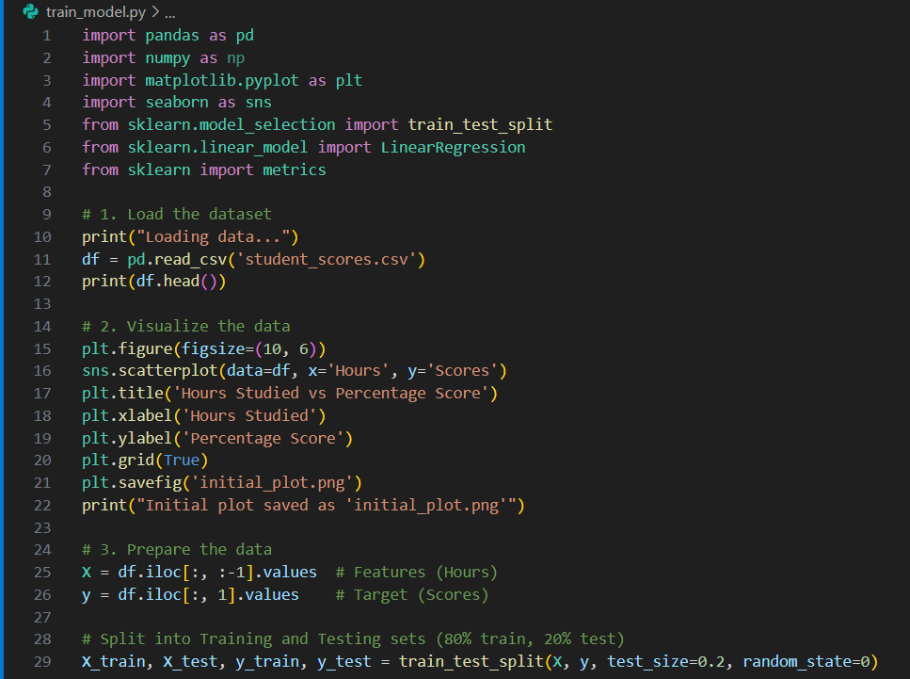
Model Training (Code)

Slide 5
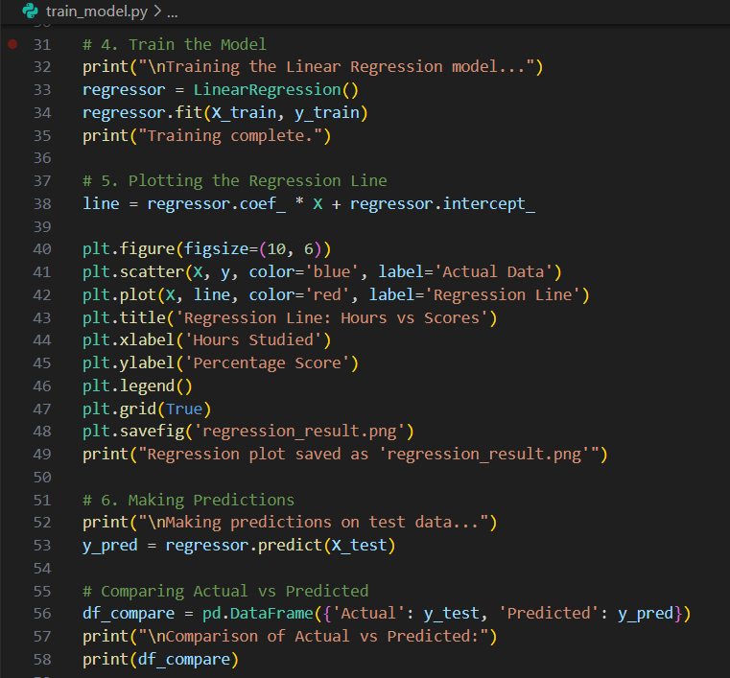
Model Training (Code)

Slide 6
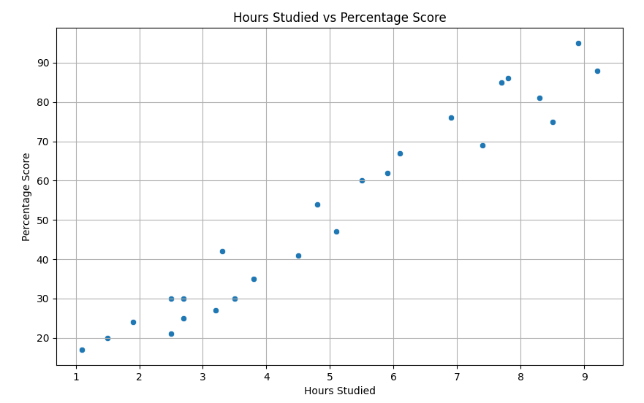
Visualizing the Correlation
Over the Training dataset

Slide 7
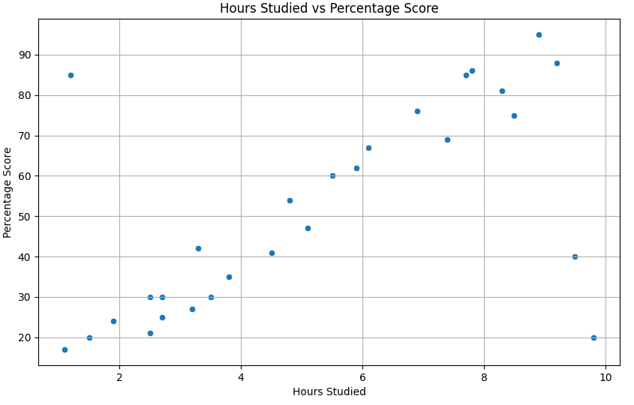
Visualizing the Correlation
Over the Testing dataset

Slide 8
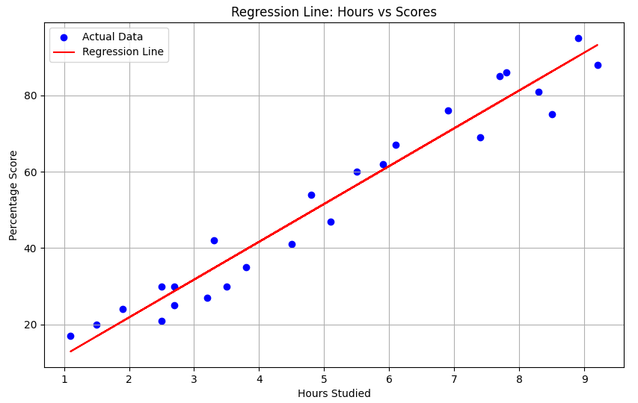
The Regression Line
Over the Training dataset

Slide 9
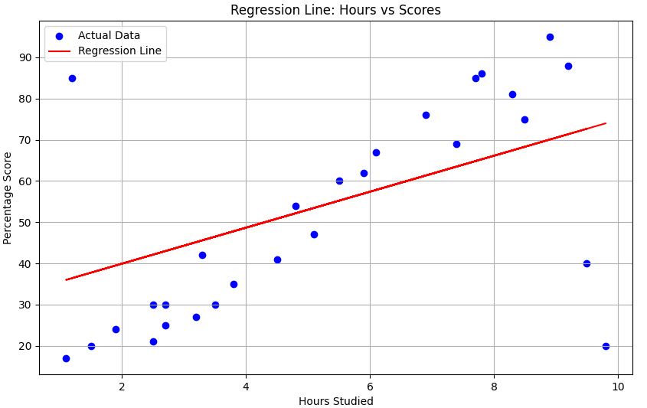
The Regression Line
Over the Testing dataset

Slide 10
Model Results
Over Training Data | Over Testing Data
Accuracy (R-Squared Score): 0.945 (94.5%) | Accuracy (R-Squared Score): 0.057 (Negative)
Mean Absolute Error: 4.18 | Mean Absolute Error: 14.71
Prediction Case: Input: 9.25 Hours of Study/Day Result: 93.69% Predicted Score | Prediction Case: with Outliers Input: 9.25 Hours of Study/Day Result: 71.58% Predicted Score

